Slide 1
teacher professional development & tour
WELCOME!
First Solar, Inc.
June 11, 2019
STEAM Program
WE ARE SO GLAD YOU ARE HERE

Slide 2
What to expect

Slide 3

INTRODUCTION
First Solar Contacts
Safety Moment
Restrooms & Water
Today’s Takeaways
Packet & Bag
Notes:
First Solar Contacts – Bryan, Shawna/Barbara (will be at both sites and available for questions, etc.)
Safety Moment – if an alarm sounds in this office, take the nearest exit/stairwell and meet with the rest of the group in the parking garage.
Restrooms & Water – down the hall, we will be able to use the restroom on our way out to the bus.
Today’s Takeaways – what we hope you learn today ….about solar technology, some of the cool tests and focus areas that FS is using in your own back yard (ATS), and how solar is impacting the world in sustainability. There will be a take home question that you can use in your classrooms to demonstrate how solar could be used to offset the energy used to power your home!
Packet & Bag – in front of you is a packet of information, please pull this out and we will go over the agenda for today.

Slide 4
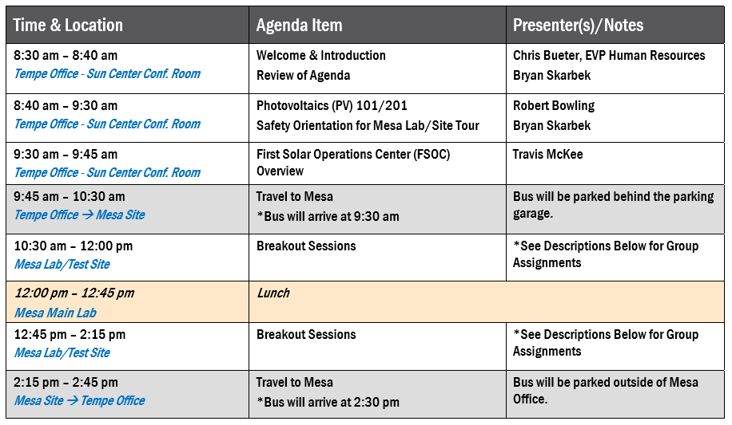
Agenda

Slide 5
PV 101/201

Slide 6
Mesa test site safety orientation basic tour edition

Slide 7
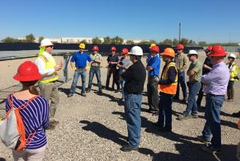
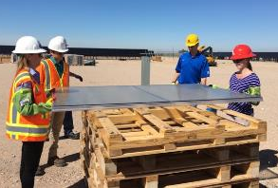
Important Note: for Tours only
This presentation has been streamlined for typical demo site tours, comprised of:
  Walking Tour of Lab and Site
  Interactive Soiling Station Demo / Trial

Slide 8

Stop Work Authority
If you feel or see something that is unsafe,
“You have the right and responsibility to
The Job
until you are satisfied it is safe to proceed”.

Slide 9
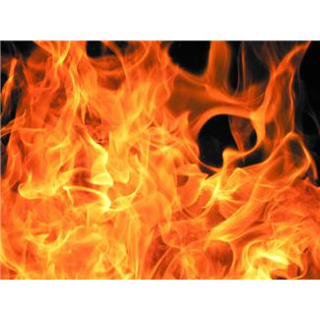
Fire/Emergency Evacuation
Everyone MUST follow the evacuation routes and exit the building when an alarm sounds.
  Assume all alarms are real
  Exit door nearest to parking lot
If smoke or fire is observed:
  Pull the nearest Fire Pull station
  Immediately exit the nearest exit
Everyone must meet at the designated assembly areas.
  Keep fire lanes clear for the Fire Department
  Check in with First Solar staff/safety members
  Meet in the East parking lot across from the building

Slide 10
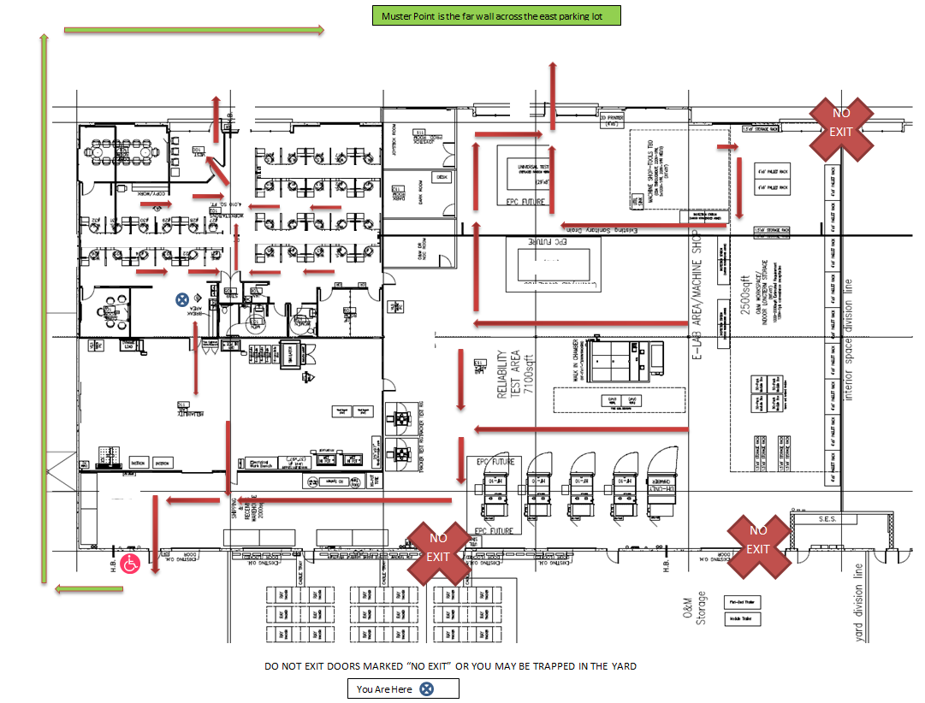
Fire/Emergency Evacuation – Mesa Site

Slide 11

Site Access / Rules
All visitors must first sign-in at the office, and complete the necessary paperwork to access the site.
  Waiver Form
  PPE Acknowledgement
Unauthorized access to the site will result in immediate removal.
  Stay with your group or First Solar host.
Use of cell phones while walking through the lab or on site is prohibited.
DRIVE SAFE, ARRIVE SAFE AND GO HOME SAFE!

Slide 12
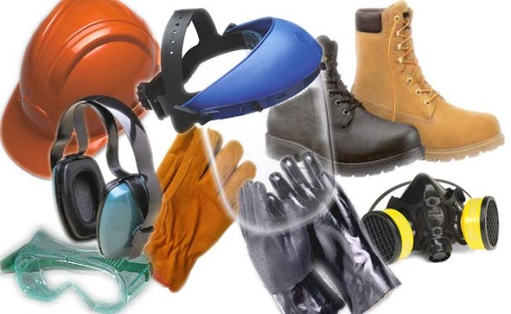
Personal Protective Equipment (PPE)
First Solar requires the following PPE, depending on visit scope:
Violations of site safety requirements will not be tolerated.
NO PPE – NO TOUR!

Slide 13
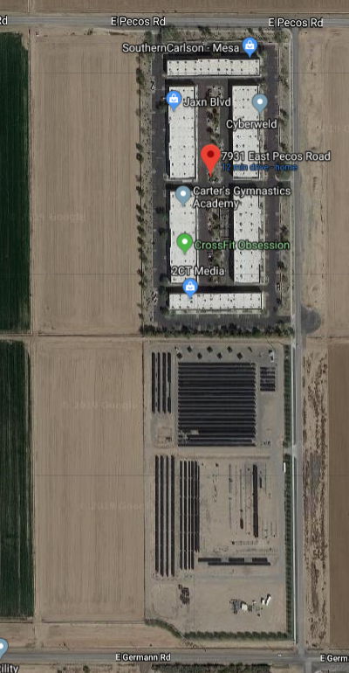


Mesa Site Map
Site is ~ 200m South of Building
  3 minute walk or drive
Please obey keep-out areas
  Hazardous and/or secret stuff
Alternate Emergency Exit is in the Northeast corner
Office
Main Gate

Slide 14



Most Common Safety Risks – Mesa Demo Site Tour
Bumping head into structure
  Wear a hard hat, and watch your head
Tripping Hazards
  Watch where you’re going
    Phones down, heads up
Cuts or scrapes from sharp metal edges
  Wear cut-resistant gloves in you plan to touch anything
    Add cut-resistant sleeves if handling modules
Insects & Critters
  Watch where you put your hands and feet

Slide 15
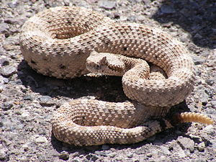
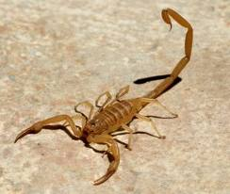
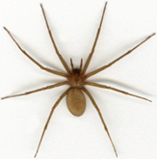
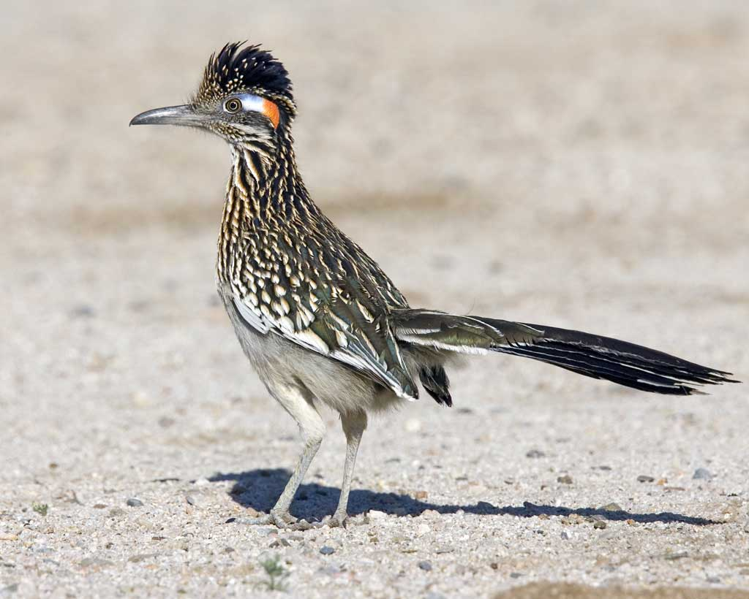
Insects and Animals On Site
3Rs- Recognize, Retreat, Report
Rattlesnakes, Scorpions and Spiders
  Rattlesnakes are rarely seen at ATS yet quite common in the area
  Scorpions and Spiders are more common.
In all cases the best defense is to be mindful of where you put your hands and feet
  Look before stepping, or before resting your hand on that torque tube
If you are bitten, don’t panic
  Stay calm, call 911 and immediately notify your First Solar host.

Slide 16
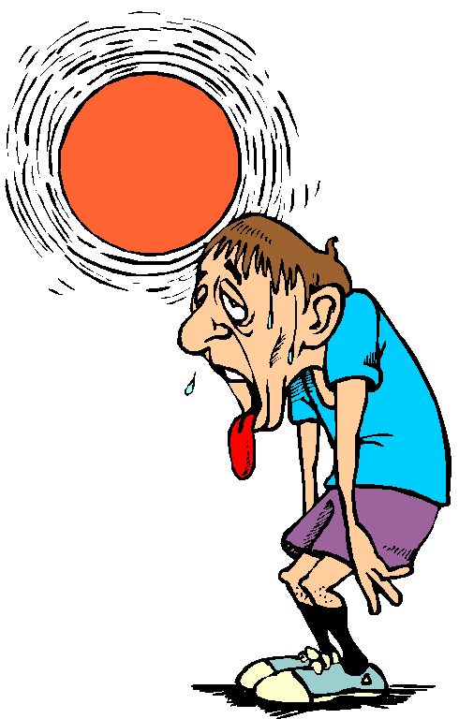

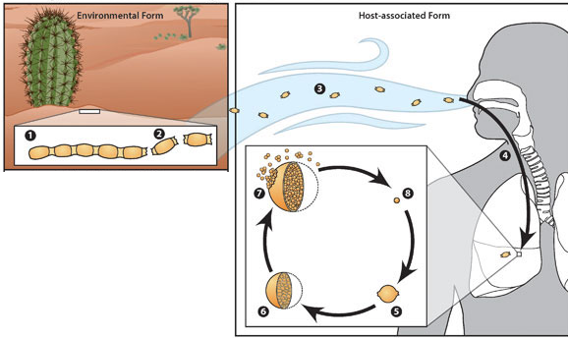
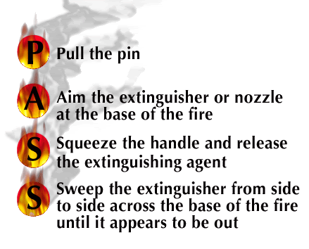
Less Common Risks – basic tour edition
Heat Illness – Heat Exhaustion, Heat Stroke
  Stay hydrated. Stay in the shade as much as possible
Moving Equipment
  Assume driver cannot see you – especially when backing up.
Valley Fever
  A soil-borne fungus that can cause flu-like symptoms. Reportedly 30-60% of people in the southwest
    We don’t disturb the soil much at ATS, though local farmers do.
  If exposed to flying dust, wear a mask or respirator, or go inside.
Blood-Borne Pathogens
  Avoid contact with blood and other bodily fluids; if contacted, assume potentially infectious.
Fire: use extinguisher if fire is small
  Otherwise exit site and call 911

Slide 17
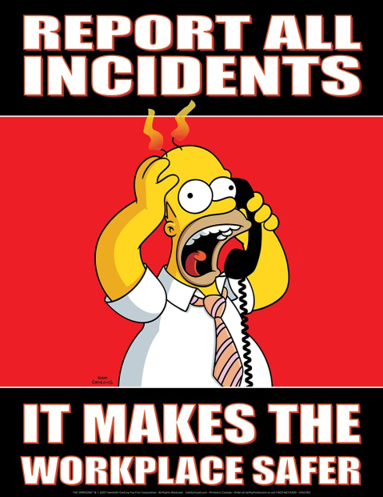
Emergencies and Incident Reporting
In the event of a life-threatening emergency, dial 911 (for phones in the office you must dial 9911)
  DO NOT attempt to lift or move an injured person
  DO NOT play doctor
  Report injuries to First Solar immediately after calling 911
Incident Reporting
  “ALL” injuries, accidents, vehicle and/or property damage must be reported to your First Solar representative ASAP - no matter how minor they may be.

Slide 18

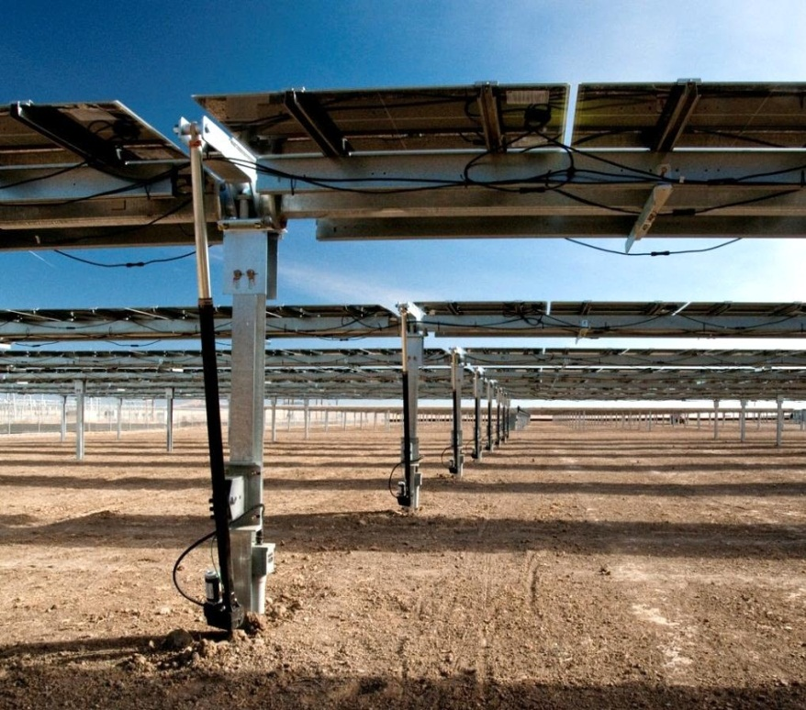
Photo / Video Policy = PROHIBITED
The Mesa Demo Site is a unique and picturesque facility, and we hope you have a memorable visit.
First Solar Communications team will be responsible for photographing this event.
Please refrain from:
  Taking photos and
  Posting photos/images on Social Media
Once the approved communications package is released, participants will be free to use the content on their personal channels.

Slide 19
First solar operations center (FSOC)

Slide 20
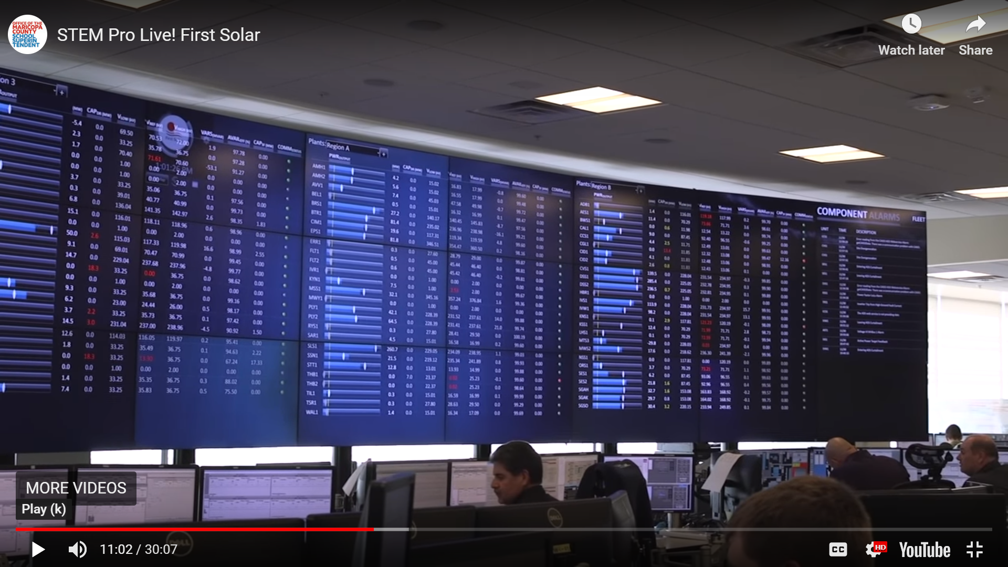

Slide 21
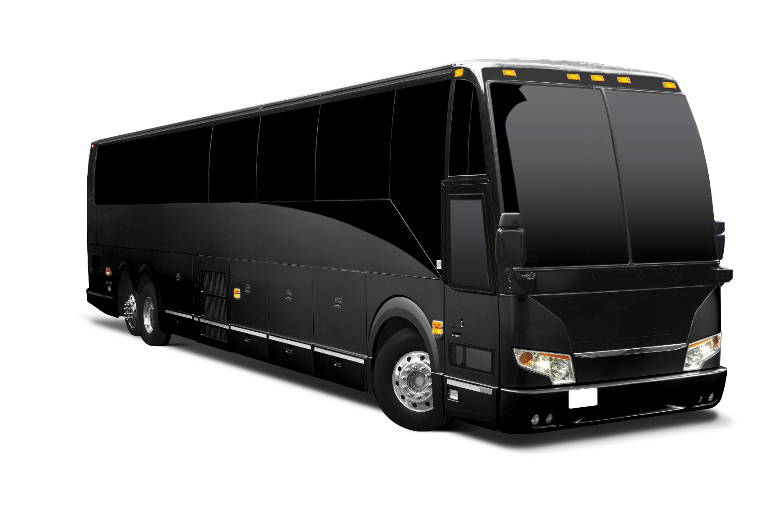
Thank you!
Bus will depart soon, please make your way to the loading area!

